Slide 1

Computer Science
Introduction to databases
Leaving Cert

Slide 2
Lesson Objectives
Students will learn about:
The difference between structured data and unstructured data
The database and its structure
The relational database and its advantage over a flat-file database
How entities (or tables) are related to each other in a relational database.

Slide 3
Content
1.

Slide 4
What is a database?
A database is an organised collection of data, that allows users to access and search the information easily.

Slide 5
Advantages of using database
Databases are better storage techniques compared to file systems.
Many users can access the data at the same time.
Databases can hold very large amounts of data.
The data is only stored once and, hence, data duplication is avoided.
The data is consistent as the changes need to be made only once. These changes are then reflected for all the users using the database.
The data is stored in an organised way, which makes it easier and faster to carry out searches of the data
Databases can interact with many different types of systems e.g. phone apps, web pages, business software

Slide 6


Social networking websites
Security systems
Applications of database
Trade management
Industrial management
Aviation management

Slide 7
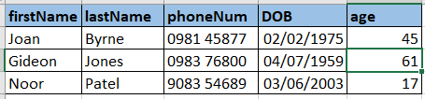
Flat File Database (the simplest)
The simplest form of database is called a flat file. An example is a .csv file
A flat file database contains only a single table. For example: contact details, product details, etc. A table is a collection of related data and is made up of rows and columns.
Each row represents a record in the database. A record holds specific items of data about someone of something

Slide 8
Structure of a table: Example
Employee number | Name | Gender | Date of birth | Department | Date of joining | Salary
Record 1
Record 2

Slide 9


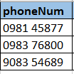



Flat File Database (the simplest)
In a database table, an attribute refers to a column name and the data that it contains
The term record is used to refer to one entry (or row) in the database. Each record contains various fields

Slide 10
Database Data Types
Each attribute in the database table contains a specific type of data, just like python variable types (string, Boolean, integer, float)
Varchar -> the first attribute in our table below contains a string. In database terminology, a string is called a varchar.
Number -> The attributes labelled phoneNum and age contain numbers. These are of datatype number.
Date -> The attribute labelled DOB contain the data type date.

Slide 11
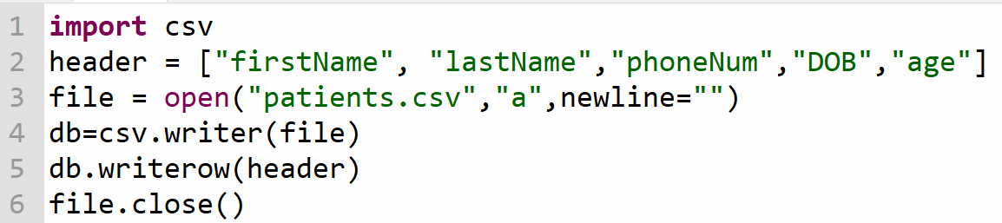
Creating a database (flat file)

Slide 12
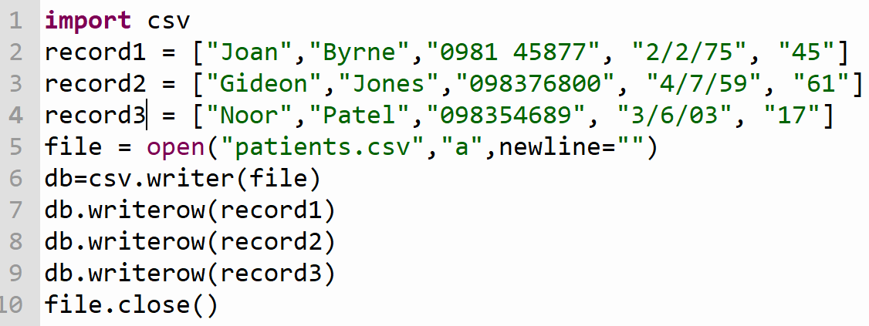
Appending records to the CSV file

Slide 13
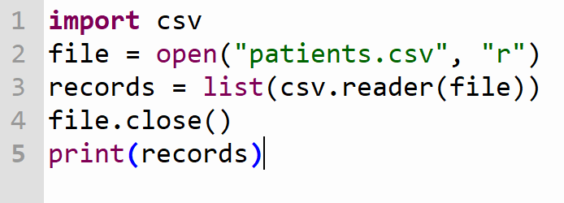
Read and Display records from the CSV file

Slide 14
Structured vs. unstructured data
Unstructured data
Information that is not structured in a predefined manner is called unstructured data.
Data in a word document or notepad are examples of unstructured data.
Structured data
Information that is stored in a predefined manner, that is, in a structure is called structured data.
Databases help us to store data in a structured manner.

Slide 15
Trevor
Name | Mobile phone number | Address
Trevor | 9783151391 | 24, Front street, Lancaster
Frederick | 8201349821 | 12, Pimlico Rd, Belgravia
24, Front street, Lancaster
9783151391
Frederick
8201349821
12, Pimlico Rd, Belgravia
Unstructured data
Structured data

Slide 16
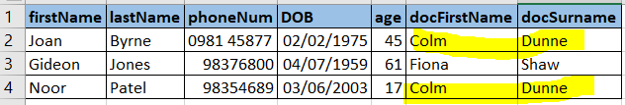
Issues with single table of data
The table contains details of patients’ record in a doctor’s clinic. If we were to build a database system for a doctor’s clinic, you will need to cross-reference by doctor as well as patient.
Each doctor has many patients, but each patient normally has only one doctor
Notice the duplication of data for the doctors in the below file.

Slide 17
Issues with single table of data
Notice the duplication of data for the doctors in the below file. This causes problems such as:
Wasted time/effort when entering and updating the data. Every occurrence of the doctor attributes will need to be updated if a detail changes e.g doctor retires or changes jobs.
Wasted storage space as duplicated data takes up extra memory space

Slide 18
What is a relational database?
A relational database is a type of database that is structured and is distributed over various tables that are connected using a relationship in a relational database. Hence, no redundant data.

Slide 19
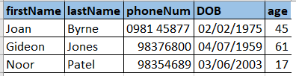

Use or two or more related tables
- Relational Database
It is better practice to split this information into 2 tables. Then define a relationship between the table
  A patient’s table
  A Doctor’s table
Patient’s Table
Doctor’s Table

Slide 20
Primary key
The purpose of a primary key is to provide a unique key to a record.
To prevent data duplication, each record uses a primary key field, which must be unique. It can be automatically generated.
A primary key may be just numbers or a combination of letters and numbers.
In the employee table, an employee number is unique for each employee and serves as the primary key.

Slide 21
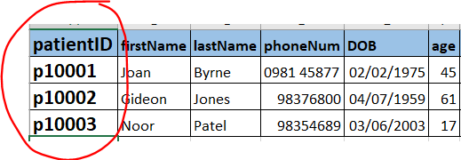
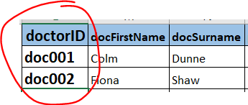
Use or two or more related tables
- Relational Database
First, need to create a PRIMARY KEY for Each patient record and each doctor record
Patient’s Table
Doctor’s Table

Slide 22
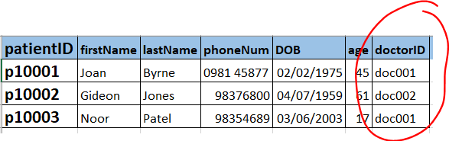

Relational Database – The Foreign Key
In the patient’s table a new attribute (column) is added called doctorID. This creates the link (relationship) back to the doctor’s table. This is the FOREIGN KEY and it is always the primary key from the other table with which you want to make the link
Patient’s Table
Doctor’s Table

Slide 23
Relational databases vs. Flat file databases
Relational database
A large set of data is distributed over various tables and connected using a relationship in a relational database. Hence, no redundant data.
A relational database is efficient over flat-file databases as it is more efficient and takes up less space in memory.
Flat-file database
Presence of redundant data, that is, repetition of data in a database.
Due to the presence of redundant data, more memory space is required and it is also less efficient.

Slide 24
Advantages of using a relational database
For example, a library may store information such as a book list, member list, department, book location, research paper list, staff details and many more.
Storing these details in a single flat-file system would lead to more memory space requirement and data redundancy.

Slide 25
Characteristics of relational database
An entity is an object in a system for which the information is stored.
A characteristic of an entity is its attribute.
In a record, attributes about an entity are stored.
For example, let us consider a book as an entity.
Author, name of the publisher, year of publication, price of the book, and ISBN number are its attributes.
Entity: Book
Attributes: Author Name of publisher Year of publication ISBN number

Slide 26
Characteristics of relational database
In a relational database, each table contains information about just one entity.
Each table has a primary key and these tables are linked together using these primary keys and foreign keys.
Foreign keys are a link to primary keys.

Slide 27
Characteristics of relational database: Example
Let us consider the database of a library with three tables:
Book with a primary key BookID
Member with primary key MemberID
Bookslent with foreign keys Book ID and Member ID

Slide 28
Characteristics of relational database: Example
The entity descriptions for the entities book and member are given as:
Book (BookID, Title, Author, Publisher)
Member(MemberID, FirstName, LastName, ValidUntil, PhoneNumber)
The primary key is underlined in entity descriptions.

Slide 29
Book:
BookID | Title | Author | Publisher
1 | Cambridge IGCSE Computer Science | David Watson and Helen Williams | Hodder Education
2 | Complete Chemistry for Cambridge IGCSE | Paul Ingram and Rosemarie Gallagher | Oxford University Press
3 | Complete Mathematics for Cambridge IGCSE | David Rayner | Oxford University Press
4 | Cambridge International AS and A Level Computer Science Coursebook | Dave Duddell and S. Langfield | Cambridge University Press

Slide 30
Member:
MemberID | FirstName | LastName | ValidUntil | PhoneNumber
M18535 | Stephen | Watson | 31/12/2019 | 1864012854
M11935 | Mary | Rayner | 5/10/2020 | 7911039811
M25183 | Marian | Miller | 4/11/2018 | 8111092210

Slide 31
Bookslent table:
It can be noticed that other attributes of books and members are not included, as these are referenced using their respective IDs.
Book ID and Member ID are the foreign keys of this table that act as a reference to other tables. These foreign keys also act as primary key for this table.
Book ID | Member ID | Date | Fine
2 | M18535 | 12/10/2018 | 0
1 | M11935 | 15/9/2018 | £ 1
3 | M25183 | 21/07/2018 | £ 3

Slide 32
Referential integrity
Referential integrity ensures that all foreign keys represent a valid and existing primary key in its parent table.
For example: In Books table, if you delete the record for BookID=2, it will create an orphaned record (shown in red colour) in Bookslent table.
BookID | MemberID | Date | Fine
2 | M18535 | 12-10-2018 | 0
1 | M11935 | 15-9-2018 | £ 1
3 | M25183 | 21-07-2018 | £ 3

Slide 33
Relationship between entities (tables)
Entities(table) are related to each other using one of the following relationships:
One to one
One to many
Many to many

Slide 34
Relationship between entities: One to one
One entity is related to another entity only. For example: A person has one email address.
Person
has
Email iD
Course 3
Student 3

Slide 35
Relationship between entities: One to many
One entity is related to many entities. For example: A library has many members.
Library
has
Member

Slide 36
Relationship between entities: Many to many
Many entities are related to many entities. For example: Many students can take a course and a course can have many students.
Student
takes
Course

Slide 37
Let’s review some concepts
Database
A database is an organised collection of data, which allows users to obtain and process information according to their requirements.
Structure of a database
Data in a database is stored in the form of tables.
Table
A table consists of various records. Each record consists of several fields.
Relational database
A relational database is a type of database that is structured and allows users to identify and access data which is in relation to other data.
Entity
An entity is an object in a system for which the information is stored. In a relational database, each table contains information about just one entity.
Attribute
A characteristic of an entity is its attribute. In a record, attributes about an entity are stored.

Slide 38
Activity
2.

Slide 39
Activity-1
Duration: 20 minutes
An online airline ticket-booking websites process the customer’s request, shows available flight details with price and prompts the user to select one of them, books the tickets and sends a copy of the ticket to the customer’s email address.
Identify the entities(tables) in the above scenario.
What relationship exists between these entities? Draw flowcharts to explain your answer.

Slide 40
Activity-1
Duration: 20 minutes
What tables do you require for an online airline ticket booking website? Show the attributes of all entities. Mark the primary keys and foreign keys (if any) of each table. Show the relationship between tables as a flowchart.

Slide 41
End of topic questions
3.

Slide 42
End of topic questions
What is a database? What are the advantages of using a database?
What are the applications of the database?
How is a database structured?
What is a relational database? What are its advantages over a flat-file database?
What I meant by the term entity, record and attributes? How are these represented in the form of a table?

Slide 43
End of topic questions
What is the difference between a primary key and foreign key?
What are the different relationship between entities? Give examples for each relationship with entity-relationship diagrams.

Slide 44
End of topic questions
A car dealer builds a database for the following entities:
Customer (CustomerID, FirstName, LastName, PhoneNumber)
Car (ProductCode, Brand, Model, Price)
Order (CustomerID, ProductCode, Accessories, TotalPrice)
Draw the entity relationship diagrams between these entities.
What is the primary key for the Order table?
What is referential integrity? In this database, how is referential integrity maintained?

